Slide 1
Chapter 21-IFPO- CPO
Crisis Intervention

Slide 2
Purpose
Security professional must learn how to reduce the intensity of the person's physical, mental, emotional and behavioral reactions to a crisis. Utilizing de-escalation to stabilize a situation may help protect against a unanticipated, behavioral sudden crisis within any organization.
Key Terms
Crisis Intervention
Disruptive Behavior
Management Stages
Levels of Behaviors
Nonverbal communications
Empathetic Listening
Controlling Behavior
Team Intervention
Safety Considerations

Slide 3
Causes of disruptive behavior
Disruptive Behavior: disrupts, interferes or prevents normal work functions
Illness or injury: diabetic shock, head injuries, missed medication.
Emotional problems or mental illness: can become verbally or physically disruptive.
Substance/Alcohol abuse or medication reaction.
Stress: inability to manage personal stress.
The silent Killer
Anger or frustration: lack the common decencies to behave.

Slide 4
Management stages
Evaluation: Investigate-who, what why and immediate dangers.
Planning: what needs to be done, how, what resources are required, what people require training?
Implement: putting the plan into action. Officer safety vital. Do not act on your own. Observe, report, await back up.
Document: detailed reports are required (5 W’s).
Review: debrief, discuss, talk about the situation, what happened, what went right, what went wrong, how can you respond better next time?

Slide 5
levels of behavior
Anxiety: visible emotions or physical movement.
Defensiveness: starting to lose control.
Anger/frustration: loss of control.
Tension reduction: regaining control.
Each level has a Response
Anxiety
Support
Defense
Reasonable limits
Anger / Frustration
Non-Violent restraint – no pain or movement
Tension Reduction
Therapeutic Rapport- communicate and debrief

Slide 6
Protection Officer Guidelines
Remain calm — move a little slower and speak a little lower. Remember that “ calmness is contagious, ” and lead by example.
Act appropriately — be serious but human.
Be objective: do not take anything personally.
Be ready to react quickly.
Watch for violence.
Be ready to protect yourself.
Be ready to protect others
Respect personal space
Maintain a minimum of 1 meter (3 feet)
Stand at an angle
(Interview stance)

Slide 7
Empathic listening
Empathic Listening allows the interviewer to more fully understand the person in crisis
Do not judge - Remain neutral
Don’t fake attention or ignore it
Encourage free following information
Listen carefully to the person
Defuse
listen for repeated themes
Use silence and repeat message back to ensure understanding.
Listen to what is being stated, do not interrupt. Use re-statement to show your were listening
Recognize their emotions (reflective listening)
Reflect on what they are saying

Slide 8
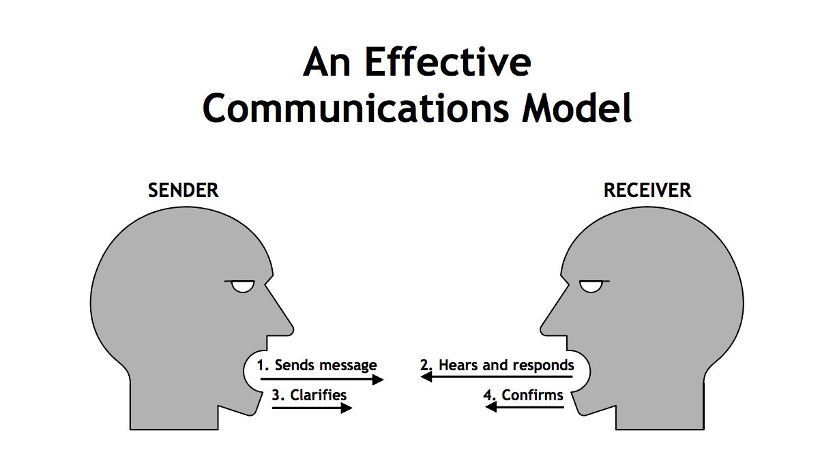
Nonverbal communications
Nonverbal communications is a message conveyed without words
85% of communication is non-verbal
Respect personal space: will differ with person
1.5 to 3 feet
Avoid crowding
May change depending on age and culture
Kinesics
Watch body posture
movement
avoid challenging person
No toe to toe or eye to eye contact
Supportive stance: stand at an angle.
Interview position
Provides room to escape
Officer safety

Slide 9
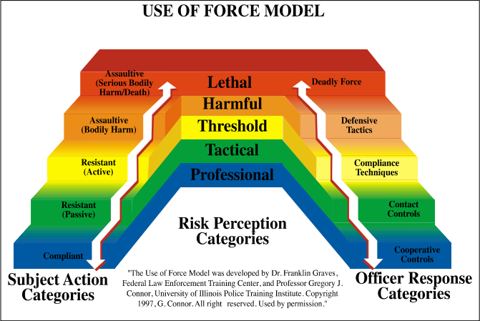
Controlling behavior
Verbally: watch voice tone, volume, and rate, use the person’s name, maintain eye contact, be respectful to person, tell them the truth about their actions.
Chemically: medications, etc are not usually an option.
Physically: Use force if other options are not available. Use for compliance, personal safety and self defense.
Other: pepper spray, tasers, firearms, if trained, qualified and follows company procedures.
Notes:
300

Slide 10
Team Intervention
Should be no more than 5.
Benefits: safety in numbers, watch each other’s back, higher level of personal safety
Professionalism: enhanced by team support and interactions and assistance.
Violence is not personal: directed at team not individuals.
Verification: witnesses to the incident in case of complaints or legal issues.
Defense the situation in a manner that reduces risk of guilt, pain or injury.

Slide 11
Leadership
Selection of a team leader
The leader will likely be the first person on the scene. Accessibility to the scene is an important consideration.
2. The leader must be confident.
3. The leader must be familiar with personnel who occupy the facility or facilities who may be a target for a crisis.
4. The leader must be familiar with the physical layout of the facility.
5. The leader should, ideally, be familiar with the acting out person or persons.

Slide 12
The leader should/must
Assess the situation
Determine what action will be taken.
2. Formulate the action plan
Put it into play as quickly and effectively as conditions allow.
3. Apprise the team of what is happening.
Each team member must know his/her responsibilities.
In the event practice/drills have not been conducted, the leader must improvise.
4. Begin the communication process.
Assess the situation.
Take whatever remedial actions are warranted.
Activate contingency plan(s) as required. Keep team members appraised.

Slide 13
When crisis intervention is required remember
Evaluate
Implement
Document
Review
Safety Considerations
Subjects can use anything as a weapons to include:
Chairs
Water pitcher
Phone
Glass
Desk accessories
Blunt or sharp objects

